Slide 1
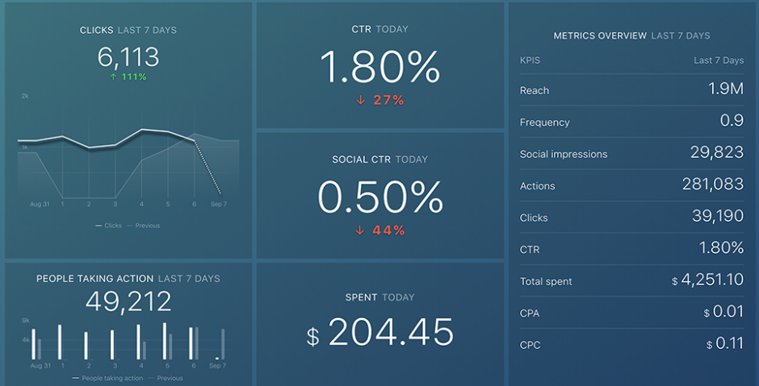
IMPACT OF CAR FEATURES
By Drustant Metar

Slide 2
PROJECT DESCRIPTION
The automotive industry is undergoing a significant transformation, driven by factors such as increasing fuel efficiency regulations, environmental concerns, and technological advancements. In this dynamic landscape, understanding consumer preferences and optimizing pricing and product development decisions are critical for manufacturers to stay competitive and maximize profitability.
Project Aims: To leverage data analysis techniques to address the following question: How can a car manufacturer optimize pricing and product development decisions to maximize profitability while meeting consumer demand?

Slide 3
APPROACH
Firstly ,we have to clean the given dataset by using some advance excel functions and techniques.
Description of the analytical methods used in the project, such as descriptive statistics, visualization, machine learning, or optimization.
Explanation of the reasoning behind the choice of analytical methods.

Slide 4
TECH-STACK USED
I used the following tools for complete my analysis:
Google drive
Microsoft excel
Microsoft power point

Slide 5
INSIGHTS
Pricing Sensitivity: After looking at the data, we found that some car features and types of cars are more affected by changes in price compared to others. Knowing which features and types are sensitive to price helps us make a pricing plan that makes the most money while still staying competitive.
Product Development Focus: We looked at what people want in cars by checking out the features, types of cars, and what people buy. This helps us decide what new features to add to future cars to make them more appealing to buyers and increase sales.
Balancing Profitability and Consumer Demand: We need to make sure we make enough money while also giving customers what they want. By using data to understand what customers are willing to pay and what they expect, we can set prices that make us money and keep customers happy.
Long-term Competitiveness: To stay ahead in the market for a long time, we use data to make smart decisions about prices and product development. By always keeping an eye on what customers like and what's happening in the market, we can change our plans as needed to keep growing and making money.

Slide 6
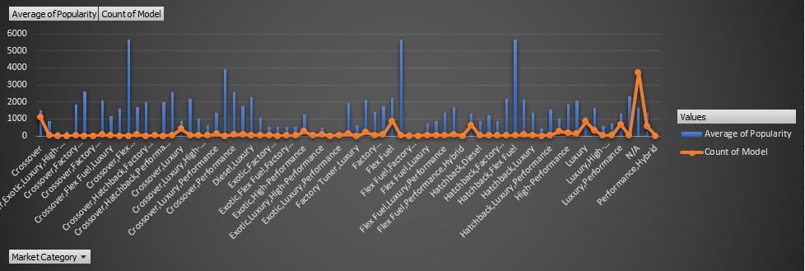
Task 1
Insight Required: How does the popularity of a car model vary across different market categories?
Task 1.A: Create a pivot table that shows the number of car models in each market category and their corresponding popularity scores.
Task 1.B: Create a combo chart that visualizes the relationship between market category and popularity.

Slide 7
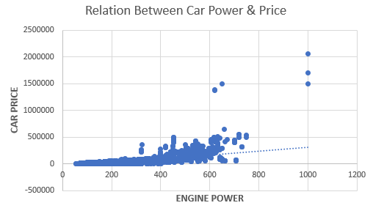
Task 2
Insight Required: What is the relationship between a car's engine power and its price?
Task 2: Create a scatter chart that plots engine power on the x-axis and price on the y-axis. Add a trendline to the chart to visualize the relationship between these variables.

Slide 8
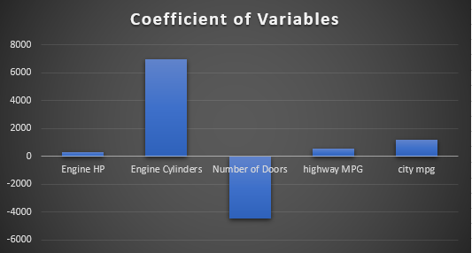
Task 3
Insight Required: Which car features are most important in determining a car's price?
Task 3: Use regression analysis to identify the variables that have the strongest relationship with a car's price. Then create a bar chart that shows the coefficient values for each variable to visualize their relative importance.

Slide 9
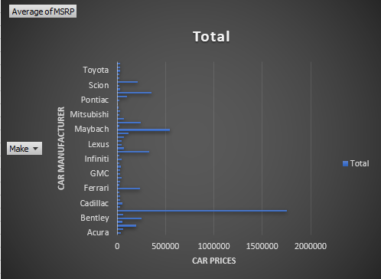
Task 4
Insight Required: How does the average price of a car vary across different manufacturers?
Task 4.A: Create a pivot table that shows the average price of cars for each manufacturer.
Task 4.B: Create a bar chart or a horizontal stacked bar chart that visualizes the relationship between manufacturer and average price.

Slide 10
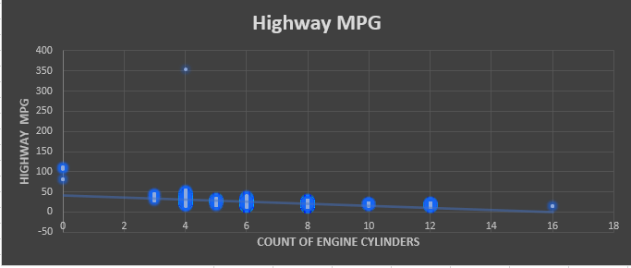
Task 5
Insight Required: What is the relationship between fuel efficiency and the number of cylinders in a car's engine?
Task 5.A: Create a scatter plot with the number of cylinders on the x-axis and highway MPG on the y-axis. Then create a trendline on the scatter plot to visually estimate the slope of the relationship and assess its significance.
Task 5.B: Calculate the correlation coefficient between the number of cylinders and highway MPG to quantify the strength and direction of the relationship.

Slide 11
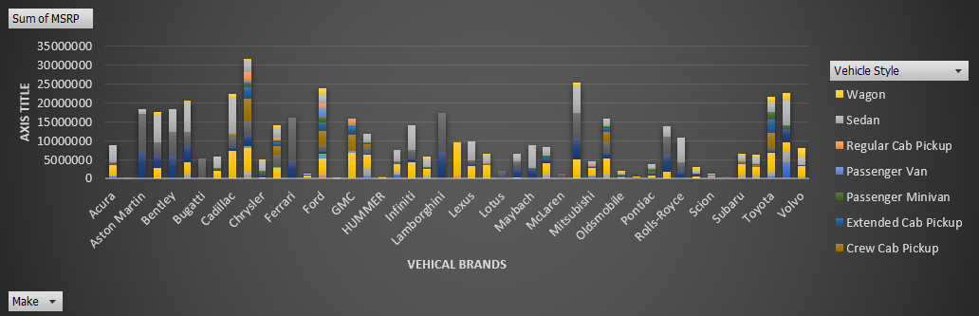
Building The Dashboard
Task 1: How does the distribution of car prices vary by brand and body style?
Hints: Stacked column chart to show the distribution of car prices by brand and body style. Use filters and slicers to make the chart interactive. Calculate the total MSRP for each brand and body style using SUMIF or Pivot Tables.

Slide 12
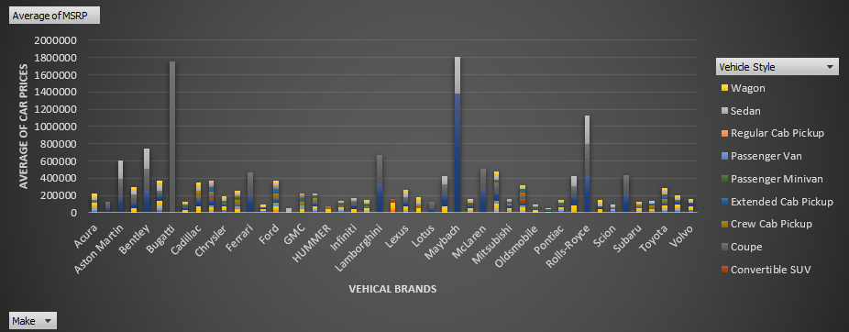
Task 2: Which car brands have the highest and lowest average MSRPs, and how does this vary by body style?
Hints: Clustered column chart to compare the average MSRPs across different car brands and body styles. Calculate the average MSRP for each brand and body style using AVERAGEIF or Pivot Tables.

Slide 13
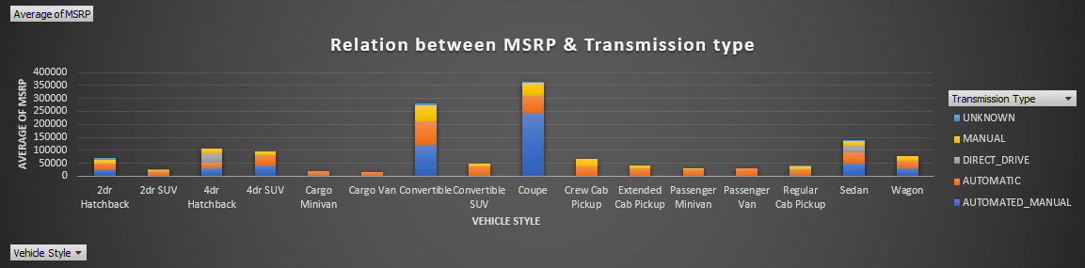
Task 3: How do the different feature such as transmission type affect the MSRP, and how does this vary by body style?
Hints: Scatter plot chart to visualize the relationship between MSRP and transmission type, with different symbols for each body style. Calculate the average MSRP for each combination of transmission type and body style using AVERAGEIFS or Pivot Tables.

Slide 14
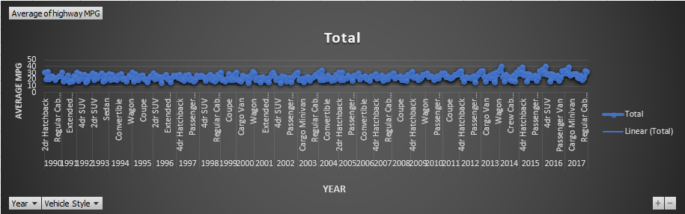
Task 4: How does the fuel efficiency of cars vary across different body styles and model years?
Hints: Line chart to show the trend of fuel efficiency (MPG) over time for each body style. Calculate the average MPG for each combination of body style and model year using AVERAGEIFS or Pivot Tables.

Slide 15
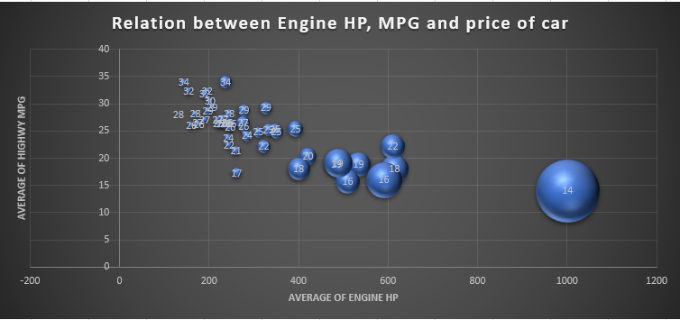
Task 5: How does the car's horsepower, MPG, and price vary across different Brands?
Hints: Bubble chart to visualize the relationship between horsepower, MPG, and price across different car brands. Assign different colors to each brand and label the bubbles with the car model name. Calculate the average horsepower, MPG, and MSRP for each car brand using AVERAGEIFS or Pivot Tables.

Slide 16
RESULT
In conclusion, data analysis provides valuable insights that drive informed decision-making in the automotive industry.
By understanding pricing sensitivity, focusing on product development, balancing profitability and consumer demand, and prioritizing long-term competitiveness, manufacturers can optimize their strategies to thrive in an ever-changing market landscape.
These insights serve as a roadmap for achieving sustainable growth and success in the automotive industry.

Slide 17
DRIVE LINK
Excel Link:
https://docs.google.com/spreadsheets/d/11mJitAUZ3O36dKYUfCrXopcop-I9sJKj/edit?usp=drive_link&ouid=110876986073115360474&rtpof=true&sd=true

Slide 18
THANK YOU

